Slide 1
INTRODUCTION
Networking And Its Devices
Presentation By:
Muhammad Faeiz
Momin Ahmad

Slide 2
Networking and its Devices
Networking is the interconnection of electronic devices, allowing them to communicate and share information. At the heart of any network are various hardware components, each serving a crucial role in facilitating seamless data transmission.

Slide 3
Understanding Network Topologies
Bus Topology
Star Topology
Mesh Topology
A single cable acts as a backbone, connecting all devices in a linear fashion.
All devices are connected to a central hub, enabling point-to-point communication.
Each device is connected to every other device, creating redundant paths for data flow.

Slide 4
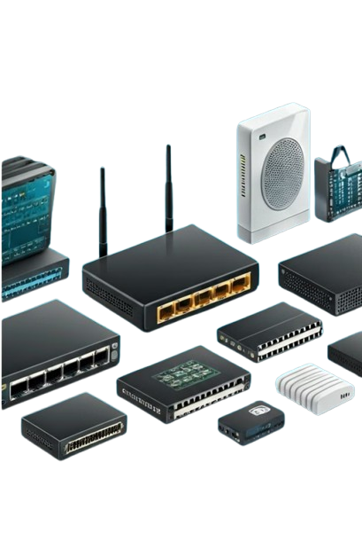



Network Hardware Components
Router
Switch
Directs data traffic between networks, connecting local and wide area networks.
Connects devices within a local network, enabling high-speed data transfers.
Modem
Network Adapter
Modulates and demodulates signals, allowing digital data transmission over analog lines.
Enables a device to connect to a network, providing wired or wireless connectivity.

Slide 5
Local Area Networks (LANs)
Confined Geography
High Speed
LANs are limited to a small geographic area, such as a home, office, or school.
LANs typically offer high-speed data transfer rates, often exceeding 1 Gbps.
Private Networks
Common Protocols
LANs are privately owned and controlled, providing enhanced security and privacy.
LANs commonly use protocols like Ethernet, Wi-Fi, and Bluetooth for connectivity.

Slide 6
Wide Area Networks (WANs)
Geographical Reach
Slower Speeds
Public Infrastructure
Due to the longer distances, WAN data transfer rates are generally lower than LANs.
WANs can span large geographic areas, even across continents and countries.
WANs often utilize public communication channels, such as telephone lines and satellite links.

Slide 7
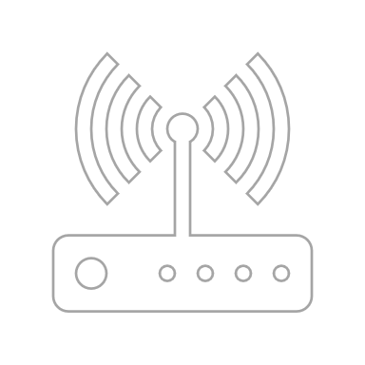





Wireless Networking Technologies
Wi-Fi
Widespread wireless standard for local area networks, enabling seamless device connectivity.
Bluetooth
Short-range wireless technology for personal area networks, ideal for device pairing.
Cellular
Mobile network infrastructure providing wide-area wireless access for internet and voice.

Slide 8
Network Protocols and Standards
1
TCP/IP
2
Ethernet
The foundational protocol suite that enables communication across the internet.
A widely adopted standard for local area network (LAN) connectivity.
3
Wi-Fi
4
Bluetooth
The industry standard for wireless local area network (WLAN) communication.
A standard for short-range wireless personal area network (PAN) connections.

Slide 9

Securing Your Network
Firewalls
Encryption
Protect networks by monitoring and controlling incoming and outgoing traffic.
Ensures the confidentiality of data by converting it into a secure format.
Access Control
Regular Updates
Restricts unauthorized access to network resources, maintaining security and privacy.
Keeping network software and firmware up-to-date is crucial for security.

Slide 10

Thank You
For Any Enquiry Contact:
faiz78181@gmail.com
Linkedin Profile

